Slide 2
Understanding More about Accessible Materials
Chris Kuehl | Specialist of Physical/Health Disabilities
Notes:
Hi, and welcome to a brief explanation of how your school can obtain accessible materials for students who require different formats to learn. My name is Chris Kuehl. I’m a Specialist of Physical/Health Disabilities and Traumatic Brain Injury at SWWC. Before moving on you may want to pause this recording to print out the PowerPoint and the handouts that are linked on the same page as this video. If you have them already, then let’s move on.

Slide 3
National Center on Accessible Educational Materials (Law: IDEA)
  AIM Accessible Instructional Materials
  NIMAC National Instructional Material Accessibility Center
  AEM Accessible Educational Materials
  CAST Center for Applied Special Technology
  PALM Purchase Accessible Learning Materials
Notes:
In order to begin I need to define a few new acronyms for you! Accessible Instructional Materials (AIM) first came into law within IDEA. Those of you who have been in education awhile remember when communities and schools had to remodel to include accessibility features like curb cuts, ramps, elevators, larger stalls in bathrooms, larger doorways, automatic entry to facilities, levers on doors, etc. Getting around used to be very difficult for some individuals. Now those common sense features are used by everyone! The National Instructional Material Accessibility Center was created because of the law changes so every state had access to learn more about the components. As time passed and technology evolved, the names were changed to the Center for Applied Special Technology (CAST) and Accessible Educational Materials (AEM). The names changed as the use of printed material became digital and accessible technologies were created. Throughout the website link on the next slide you will see the acronyms used interchangeably. Originally NIMAC/AIM focused on assisting students K-12. Currently CAST/AEM continues supporting that age group along with expanding to support individuals in post-secondary and in the workforce. PALM stands for purchase accessible learning materials which will come later in the presentation.

Slide 4
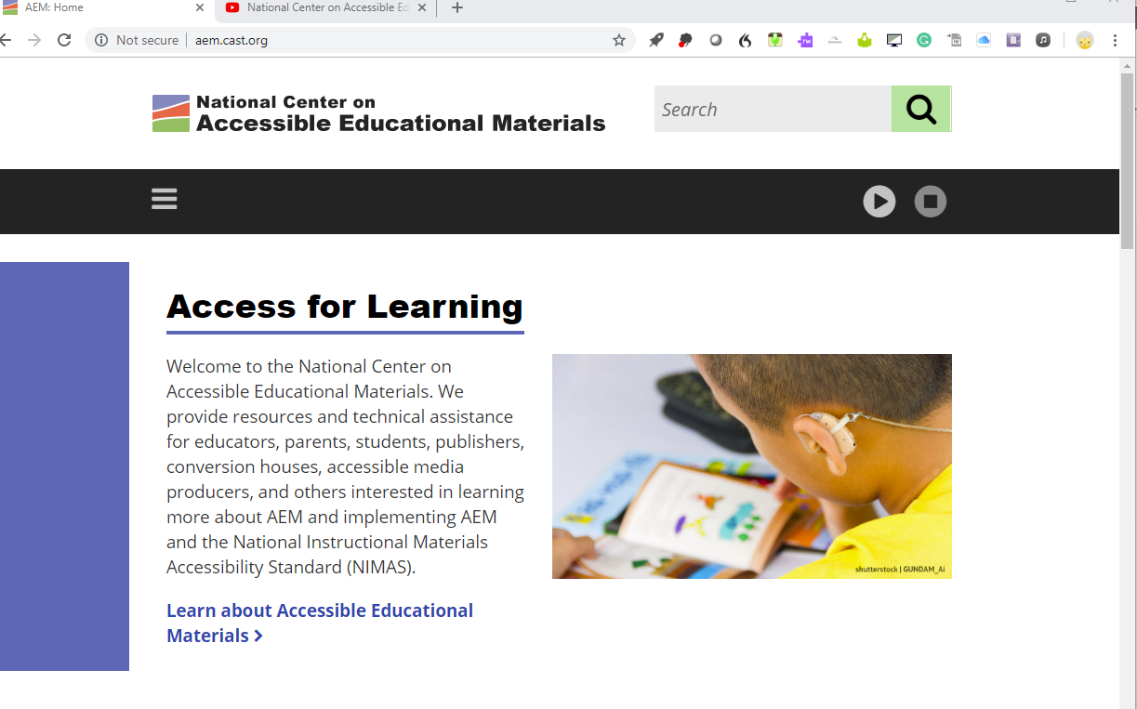
Website: http://aem.cast.org/
Notes:
Accessible Education Materials (AEM) are important to obtain so all students can have access to learning. The AEM Center focuses on helping others understand and implement specialized formats of printed materials (such as large print, Braille, and audio formats) and digital formats (having text read out loud, word prediction, speech to text, hovering over a word to learn the definition, etc.). Bookmark the website link at the top of the slide!

Slide 5
YouTube - Watch & Learn
https://www.youtube.com/user/AIMNationalCenter
Sample: Understanding AIM https://www.youtube.com/watch?v=JcPIMlOJJkc
Notes:
You tube has everything, right? Let’s watch a brief video to learn more about accessible education materials. The second video is also from their website. There are many videos to support your understanding of what accessible materials looks like and how supportive the tools can be for individuals with print disabilities.

Slide 6
Handout for Your Curriculum Director
When your district is buying new curriculum, the district needs to inform the vendor that you want the materials printed in specialized formats. Here’s the link to get you started:
http://aem.cast.org/navigating/five-things-about-buying-accessible.html
Notes:
When your district is buying new curriculum, the district needs to inform the vendor that you want the materials printed in specialized formats along with the printed textbooks/workbooks, digital formats. It is the vendors responsibility to provide those specialized formats if you have students who need those in your school. The school district won’t have to pay extra for it, but you have to make sure you are requesting it when you order. Let’s look at the link.

Slide 7
PALM Initiative
Purchase Accessible Learning Materials
http://aem.cast.org/navigating/palm.html
Notes:
Here’s the last acronym for today. Now that you know more about what accessible educational materials are your district will want to see the process to order these specialized materials. Let’s look at the link.

Slide 8
Handout for Educators
Learn ways to make content you already have accessible.
Ex. Bookshare, Audible, ibooks, Dolphin Easy Reader, Read 2 Go, Voice Dream Reader
Notes:
There are two handouts connected with this tutorial. The first one is for educators. It is a resource for you to learn about ways you can make content you already have in your special education classroom and in a general education classroom accessible. Some of the supports listed are free for qualifying individuals, some or free for everyone, others typically cost less then $20.

Slide 9
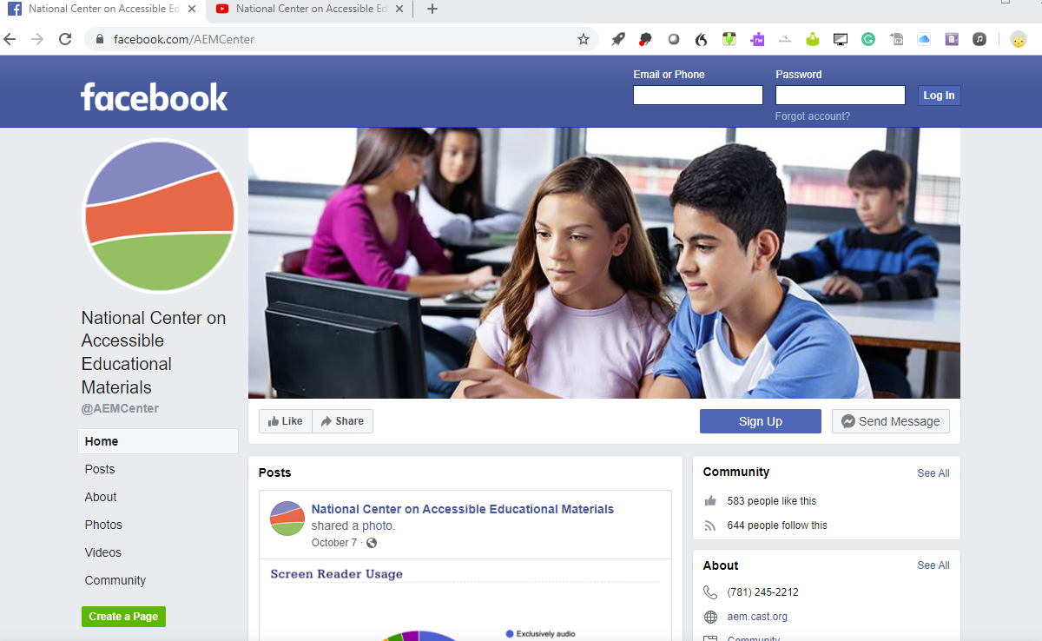
Tons of Information!
Consider adding this topic at a PLC
Set a goal to read one thing/month- insert it in a binder or computer folder.
Follow on Facebook and Twitter
Notes:
I’ve created this brief introductory level webinar to light a fire under school districts to work smarter, not harder! Though all of this may seem a bit overwhelming on your already full plate, please consider setting a new goal for yourself to explore more about this topic on a monthly basis or add it to the agenda of a professional learning community that you are a part of.

Slide 10
Notes:
Thank you for your time! Thank you for helping to ensure all learners have access to educational materials….without the hassle! ☺

